Slide 1


Franklin County Building Inspections Department
Dock Safety

Slide 2

“A collaborative effort between three localities and private sector electrical contractors to provide uniformity with inspections for residential docks, striving to ensure safe, code compliant electrical installations”.

Slide 3
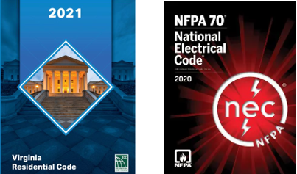
Our Code Resources
VRC
NEC

Slide 4
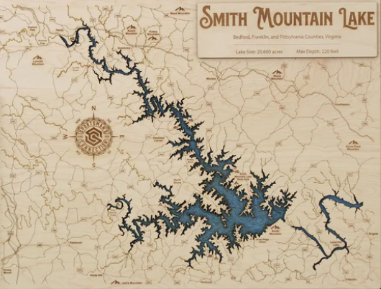
We mainly think of SML when dealing with docks even though we also have Leesville and Philpott Lakes in our jursidictions.

Slide 5
What is ESD or Electric Shock Drowning?
Electric Shock Drowning (ESD) is the result of the passage of a typically low-level AC current through the body with sufficient force to cause skeletal muscular paralysis, rendering the victim unable to help himself / herself, while immersed in fresh water, eventually resulting in drowning of the victim. Higher levels of AC current in the water will also result in electrocution. Electric Shock Drowning (ESD) has become the catch all phrase that encompasses all in-water shock casualties and fatalities. Although Electric Shock Drowning can occur virtually in any location where electricity is provided near water, the majority of Electric Shock Drowning deaths have occurred in public and private marinas and docks. The typical victim of Electric Shock Drowning is a child swimming in or around a marina or dock where electricity is present. The electricity that enters the water and causes Electric Shock Drowning originates from the wiring of the dock or marina, or from boats that are connected to the marina’s or dock’s power supply. Would you consider stepping into a bathtub or swimming pool with a hair dryer? Think of the boat as the hairdryer. If an electric fault occurs on a boat while it is connected to a marina’s or dock’s shore power and the boat or marina is not properly wired to meet current ABYC and NFPA standards, the water surrounding the boat will become electrified.

Slide 6
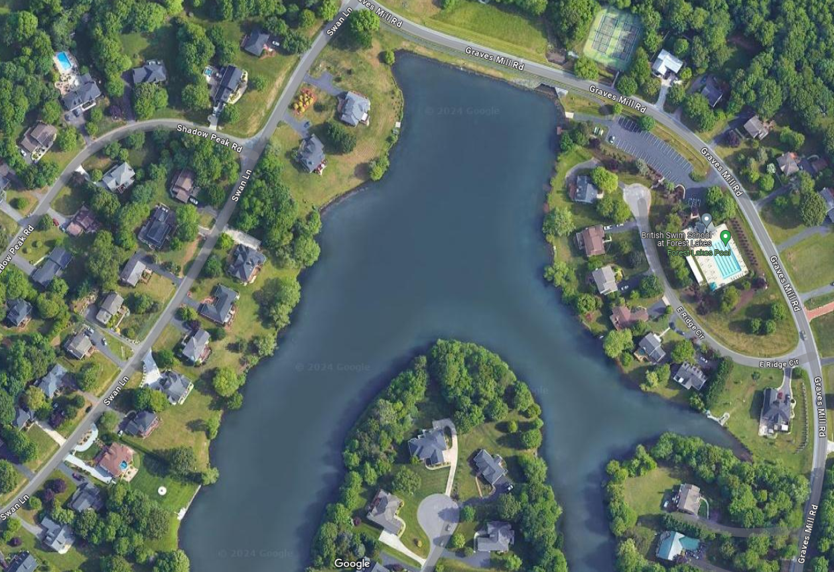
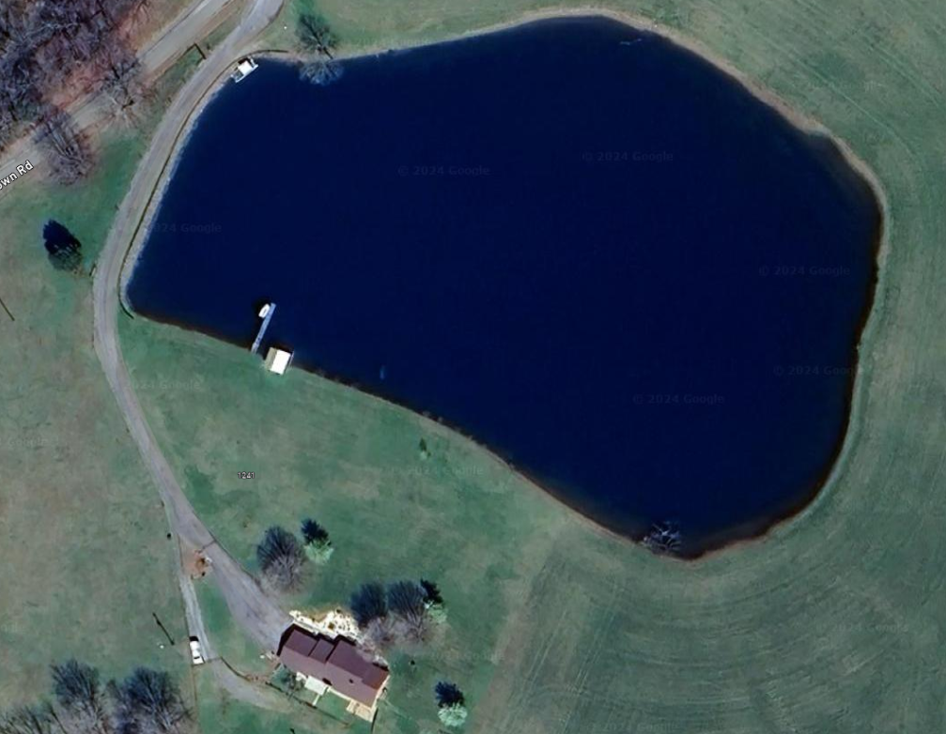
What About Subdivision and Home Lakes or Ponds?

Slide 7
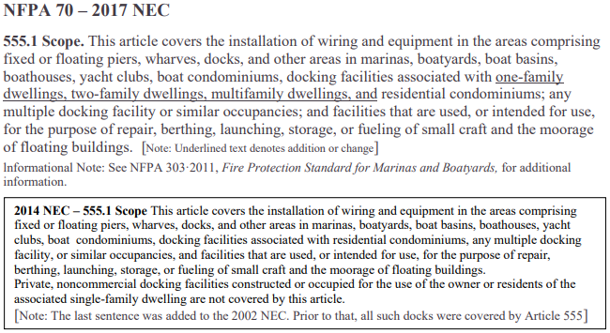
The answer is NO, it does not. Electric Shock drowning can occur anywhere there is water and electricity. This is one reason that the 2017 NEC Article 555.1 added “one-family dwellings, two-family dwellings, multi-family dwellings.”
As recent as the 2014 NEC, these were specifically exempted.

Slide 8
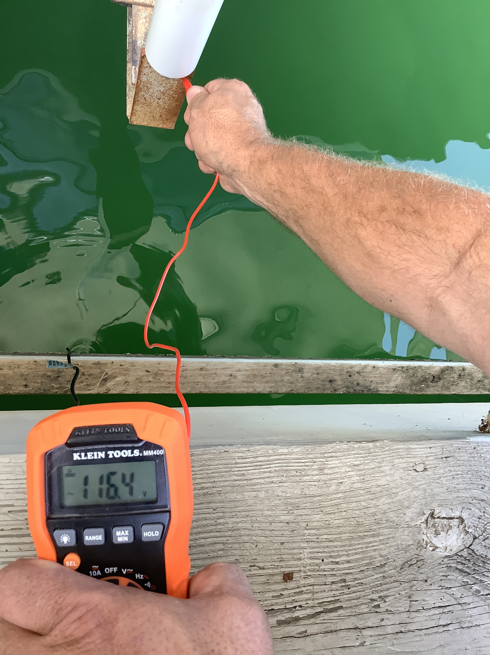
SMITH MOUNTAIN LAKE, Va. (WFXR) – The Bedford County Sheriff’s Office says one person was killed and two more suffered minor injuries during an outing at Smith Mountain Lake on July 4. Details remain limited; however, Bedford County Sheriff’s Office told WFXR that three people at a private home with a dock were gathering with family and friends when the incident occurred. Witnesses at the scene told deputies they saw the victim was in distress. The two juveniles then entered the water in a rescue attempt and they also immediately began to feel shocked.
Headlines we never want to see……………………….

Slide 9
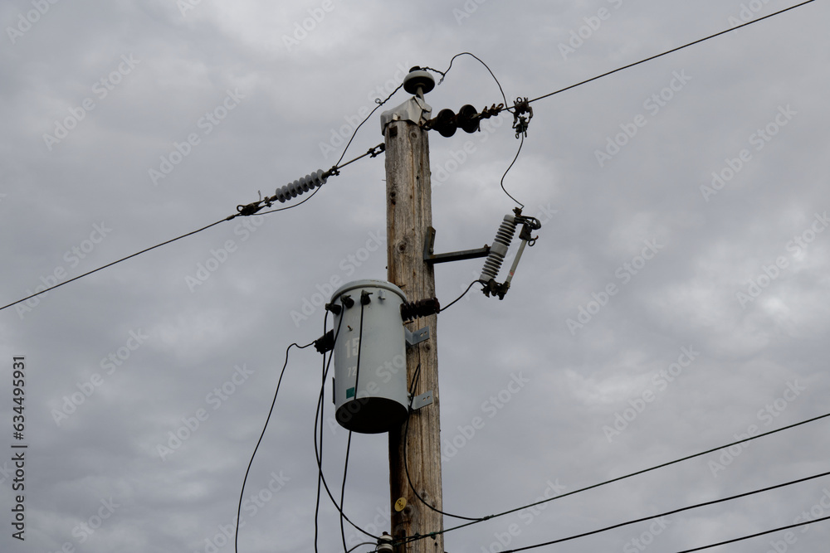
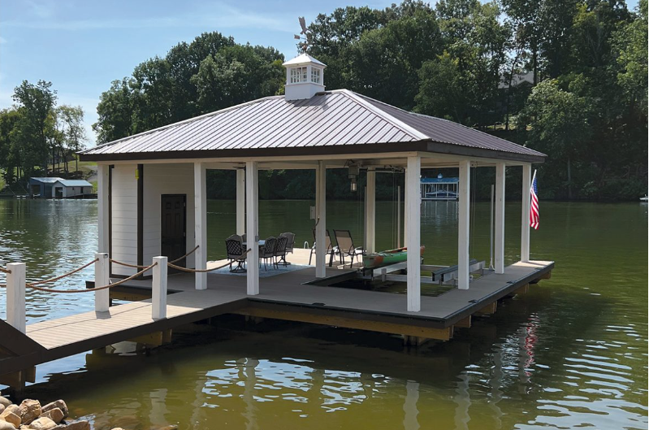
So, how does electricity get in the water?
Utility provider stray voltage issues:
Faulty on-premises wiring issues:
9

Slide 10
Faulty On-Premises wiring issues:
1. Power Surges
2. Weekend Electrician- “hey I know a friend who does some wiring”
3. Constant weathering, wave action, moisture.
4. Incorrect grounding and/or bonding.
-What is the path of grounding?
-Does the fault current have a safe, path of least resistance back to
the service/Grounding Electrode System?

Slide 11
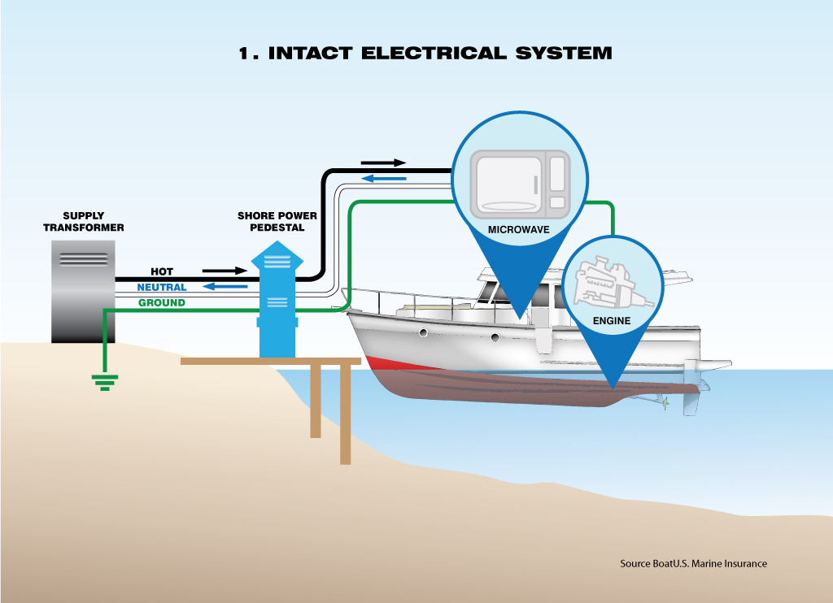

Slide 12
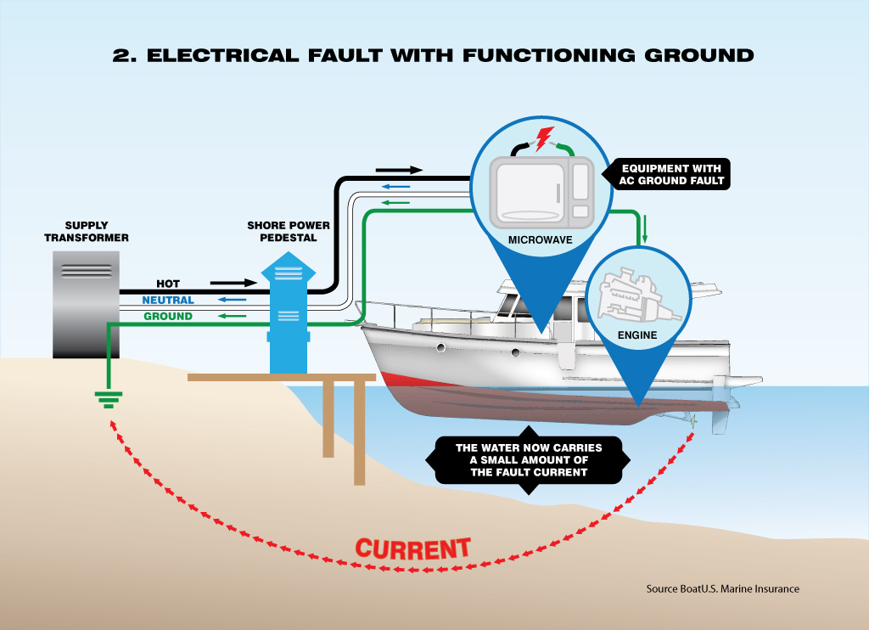

Slide 13
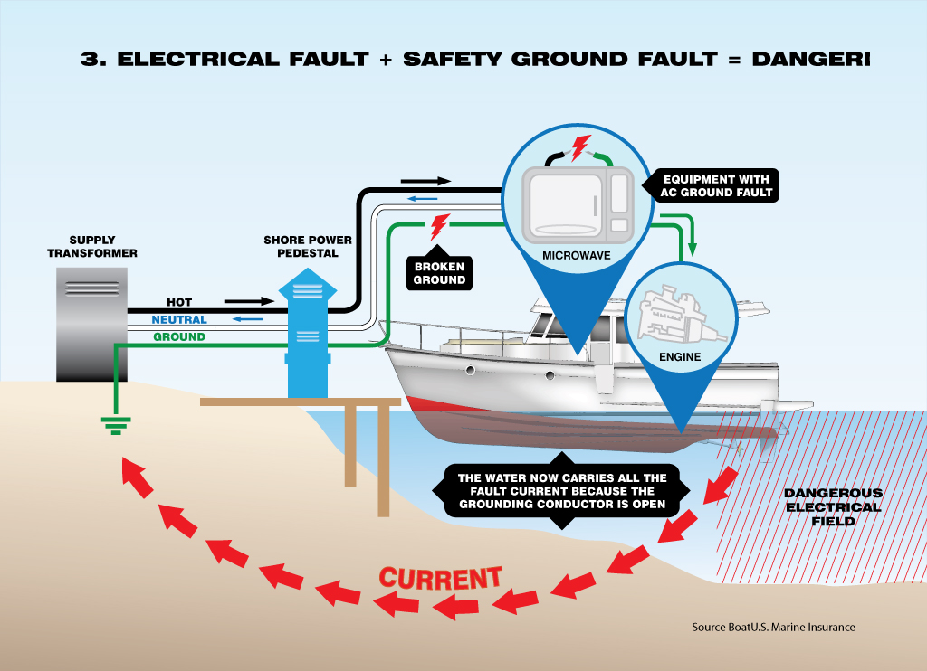

Slide 14
555.1 Scope
This article covers the installation of wiring and equipment in the areas comprising fixed or floating piers, wharves, docks, floating buildings, and other areas in marinas, boatyards, boat basins, boathouses, yacht clubs, boat condominiums, docking facilities associated with one-family dwellings, two-family dwellings, multifamily dwellings, and residential condominiums; any multiple docking facility or similar occupancies; and facilities that are used, or intended for use, for the purpose of repair, berthing, launching, storage, or fueling of small craft and the moorage of floating buildings.

Slide 15
555.2 Definition – Electrical Datum Plane
A specified distance above a water level which electrical equipment can be installed and electrical connections made.

Slide 16
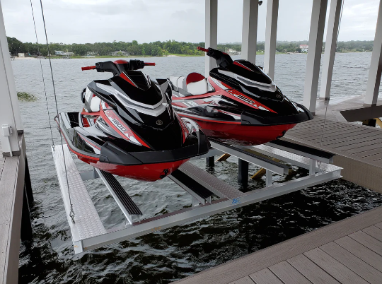
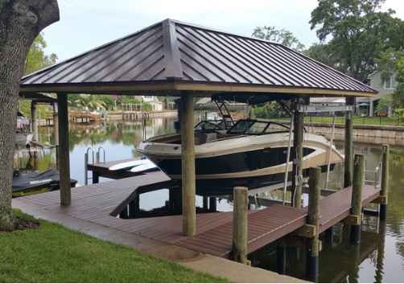
555.9 Boat Hoist
GFCI protection for personnel shall be provided for outlets not exceeding 240 volts that supply a boat hoist installed at dwelling unit docking facilities.

Slide 17
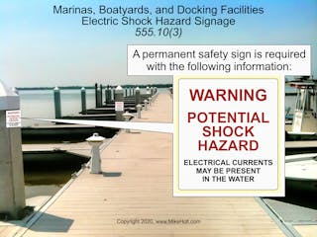
555.10 Signage
Permanent safety signs shall be installed to give notice of electrical shock hazard risks to persons using or swimming near a docking facility, boatyard, or marina and shall comply with all of the following:
The signage shall comply with 110.21(B)(1) and be of sufficient durability to withstand the environment.
The signs shall be clearly visible from all approaches to a marina, docking facility, or boatyard facility.
The signs shall state "WARNING - POTENTIAL SHOCK HAZARD - ELECTRICAL CURRENTS MAY BE PRESENT IN THE WATER."

Slide 18
555.10 Signage
The three localities agreed that one sign installed on the land approach and one facing the water would meet the code requirement for “all” approaches.
Remember, it’s a “warning” that a potential shock hazard may be present. We do not want a sign that says “NO SWIMMING”.
The sign shall be a minimum of 12”x 12” with lettering 2” in height. The color should be of contrasting with the background.

Slide 19
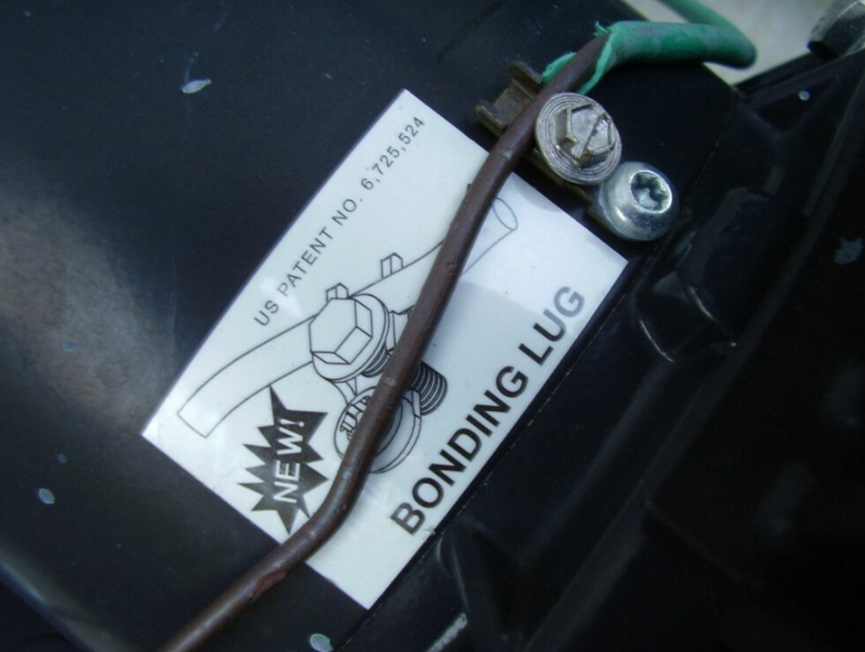
555.13 Bonding of Non-Current Carrying Metal Parts
All metal parts in contact with the water, all metal piping, and all non-current carrying metal parts that are likely to become energized shall be connected to the grounding bus in the panelboard using solid copper conductors, insulated, covered, or bare; not smaller than 8 AWG. Connections to bonded parts shall be made in accordance with 250.8
Typically, the boat hoist system is the main metallic item but could be parts of the dock if constructed with metal.

Slide 20
555.33 Receptacles
Receptacles shall be mounted not below the electrical datum plane. (A specified distance above a water level which electrical equipment can be installed and electrical connections made). Minimum height of any electrical device, equipment, etc. for all three lake localities has been agreed on to be 4’ from the fixed walking surface of the dock.
555.33 (B) Other than shore power. (1) GFCI protection for personnel. Receptacles in other locations shall be protected in accordance with 210.8
555.35 (2) also requires gfci protection for receptacles other than for shore power for maintenance and other purposes.

Slide 21
555.35 (3) Feeder and Branch Circuit Conductors with GFPE
Feeder and branch-circuit conductors that are installed on docking facilities shall be provided with GFPE set to open at currents not exceeding 100 milliamperes.
1. Feeder: The feeder running from house, garage, pedestal disconnect, etc. must have gfci protection, i.e. a gfci breaker.
2. Branch-circuit conductors: The circuits running from the sub-panel to devices and equipment on the dock must have gfci protection.
No more of just relying on the gfci protection in the boat hoist cord and gfci receptacles. The feeder to the dock and ALL breakers in the dock sub-panel, including 240-volt circuits for irrigation pumps must have gfci protection.

Slide 22
555.37(B) Type of Equipment Grounding Conductor
The equipment grounding conductor shall be an insulated conductor with a continuous outer finish that is either green or green with one or more yellow stripes.
Most electricians will opt or have in the past, used type UF such as 12/3 and re-identified the red conductor as green to meet this requirement and snipped the bare ground out.

Slide 23
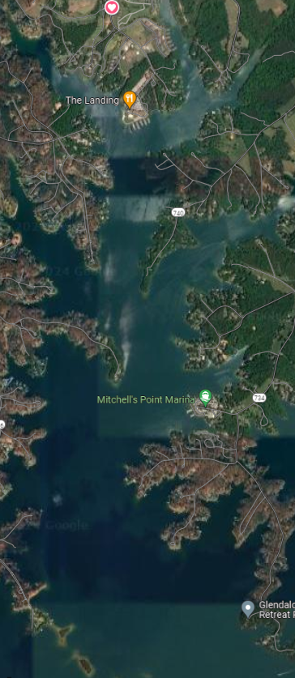
We now know how to inspect a new dock but what about existing ones?
There are literally thousands of docks on SML alone! This photo is a snapshot of the Craddock Creek area in Bedford County. Not counting ANY commercial docks / marinas, there are 537 single family docking facilities!
Think about the growth that SML has had starting in the 1980’s into the early 2000’s. Thousands of docks 20 – 40 years old, aging in a harsh marine environment.
New docks, no problems but what about the existing ones. How do we address them?

Slide 24
We now know how to inspect a new dock but what about existing ones?
4. How do we try and ensure safe docks in our localities with our existing facilities with no authority to enter the property to inspect?
* Add dock electrical inspection requirements, performed by a licensed electrician on all short-term rentals.
* PR through social media, civic orgs., fire departments, Smith Mtn. Eagle, TV news ??
* Recommend inspections by a licensed electrician on the docks electrical system.
* Recommend upgrading system to current NEC article 555 requirements.

Slide 25

The End…. Questions??

